Slide 1

Neuroimaging & 2D Brain Segmentation
Cassius (C.J) Harris, Carlos Gutierrez-Gonzalez, Joshua Lee
Supervised by Dr. Thomas Funck
Center for Integrative Developmental Neuroscience
2025 CMI YMHA Summer Internship Program

Slide 2
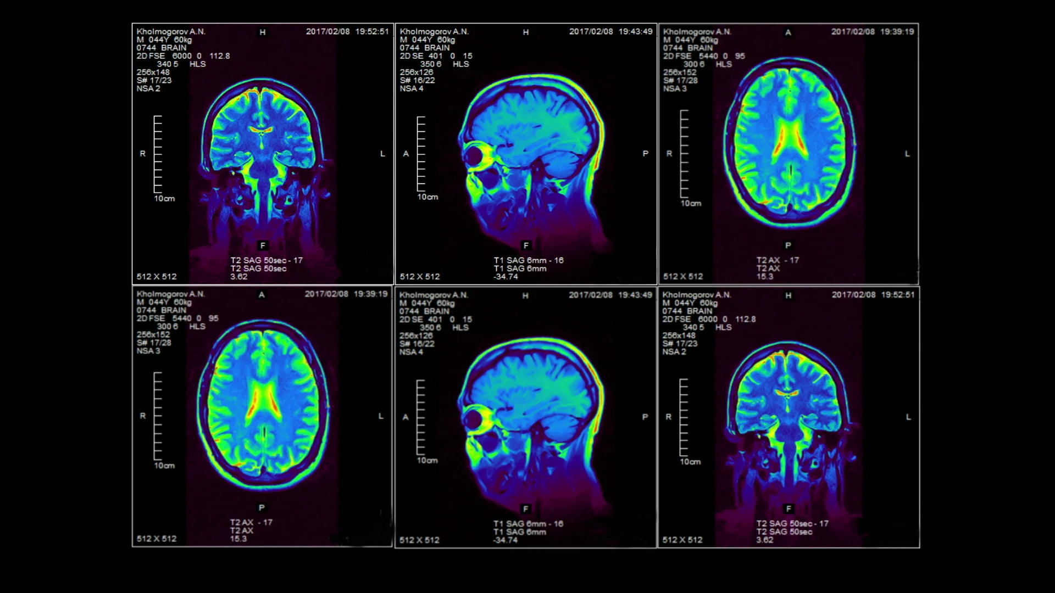

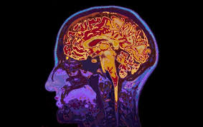


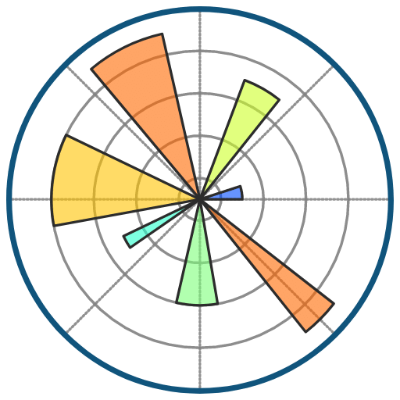
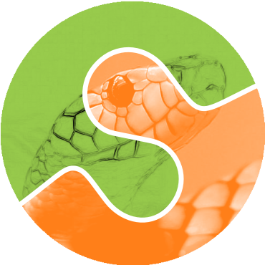
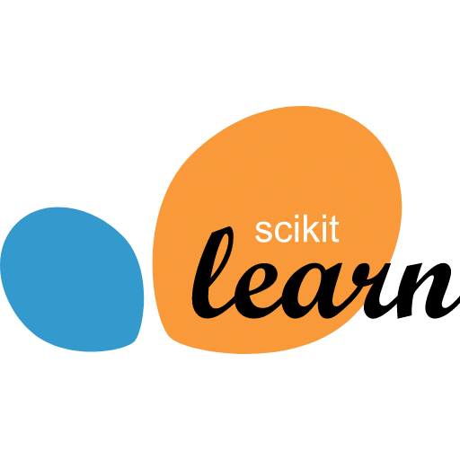
What is Neuroimaging?
“Neuroimaging is a branch of medical imaging that focuses on the brain. In addition to diagnosing disease and assessing brain health, neuroimaging also studies:
How the brain works
How various activities impact the brain”
-University of Utah-

Slide 3
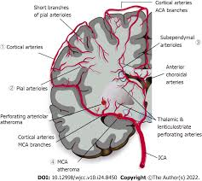
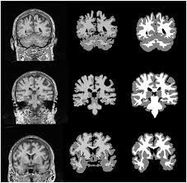
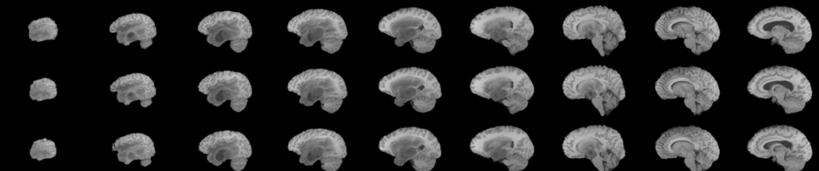
Tasks/Purpose
What do we do?
We used imaging tools to segment the Grey matter (the outer layer) from the White matter(the inner layer) of 2D brain images.
How does this help?
This helps us get a better in-depth understanding on how the brain is structuring through each layers.
Notes:
C.J
Next slide josh
Gray matter is a crucial component of the central nervous system, primarily found in the brain and spinal cord. It's composed of neuronal cell bodies, dendrites, glial cells, capillaries, and the neuropil (unmyelinated axons and dendrites). It's responsible for processing information, controlling movement, memory, emotions, and other cognitive functions.

Slide 4

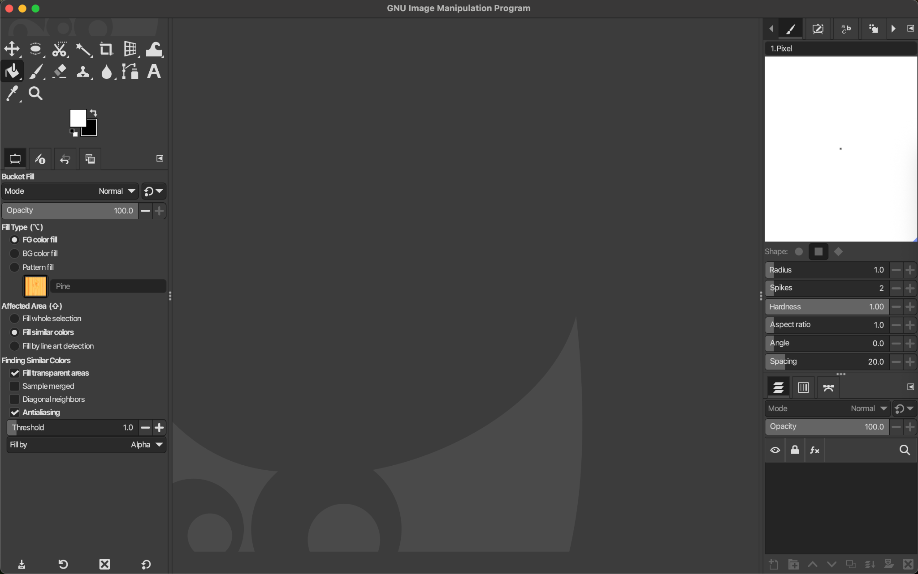
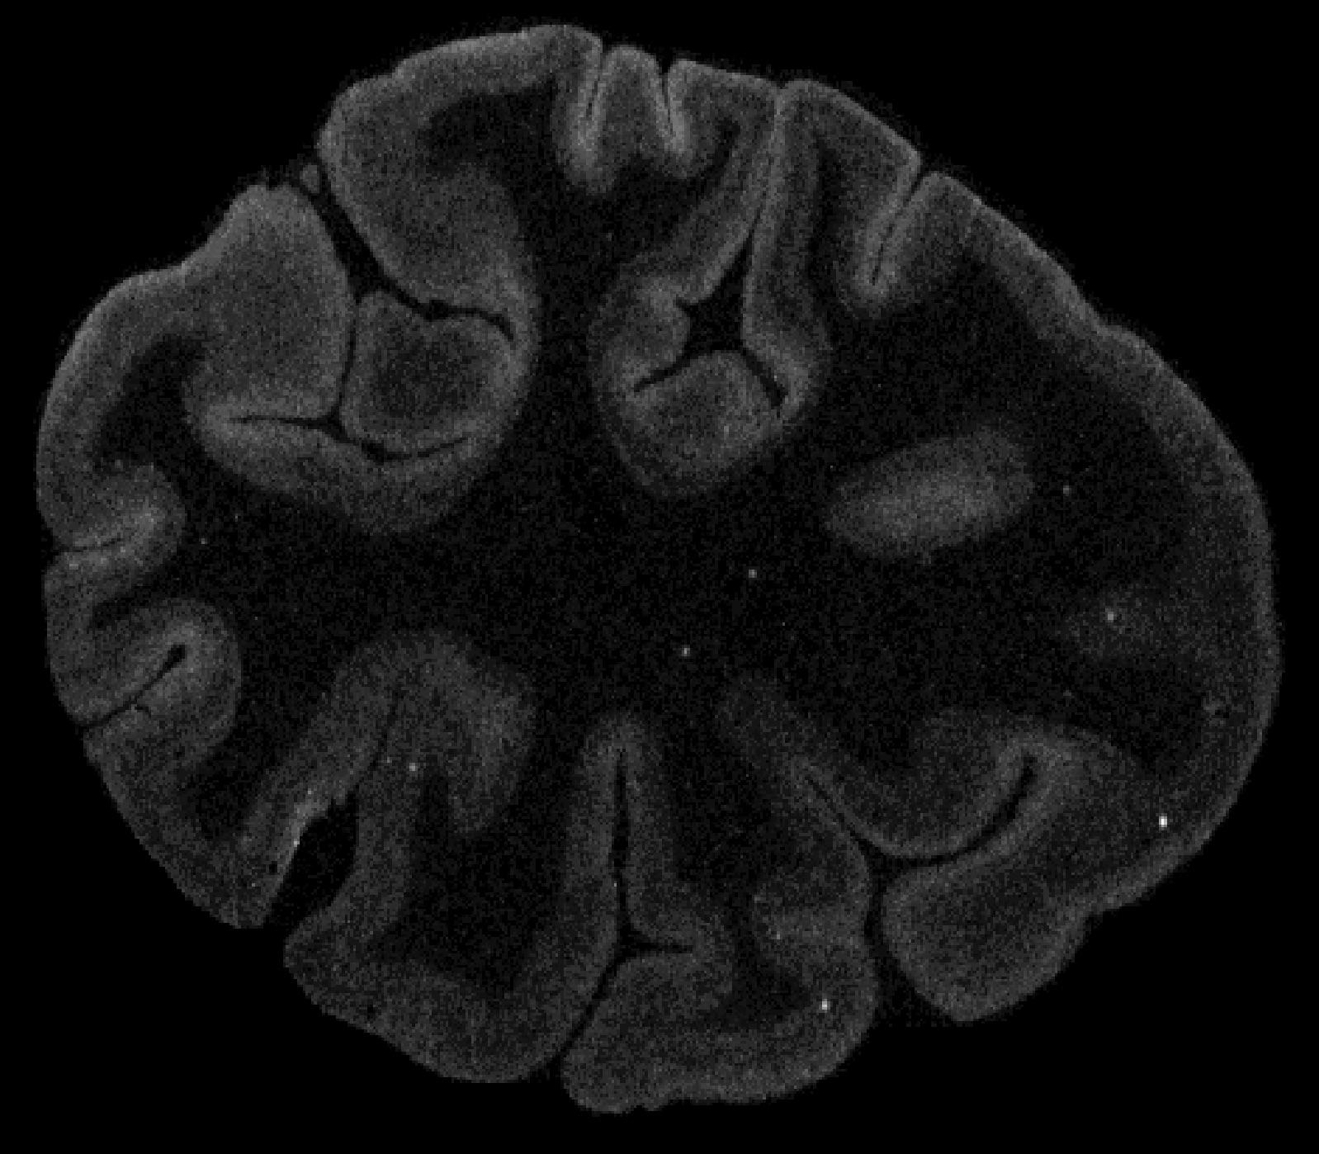


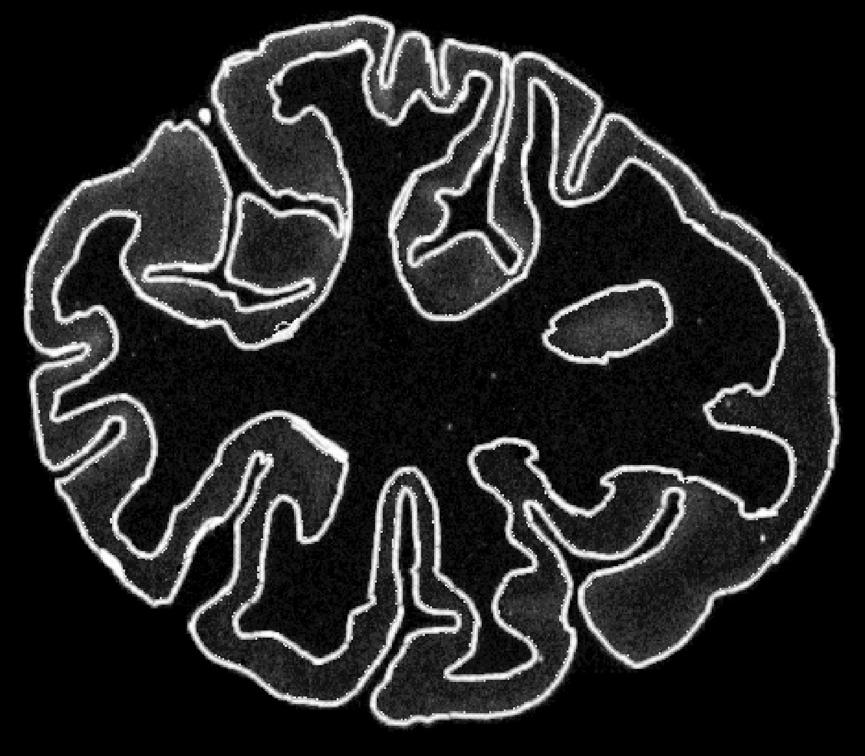
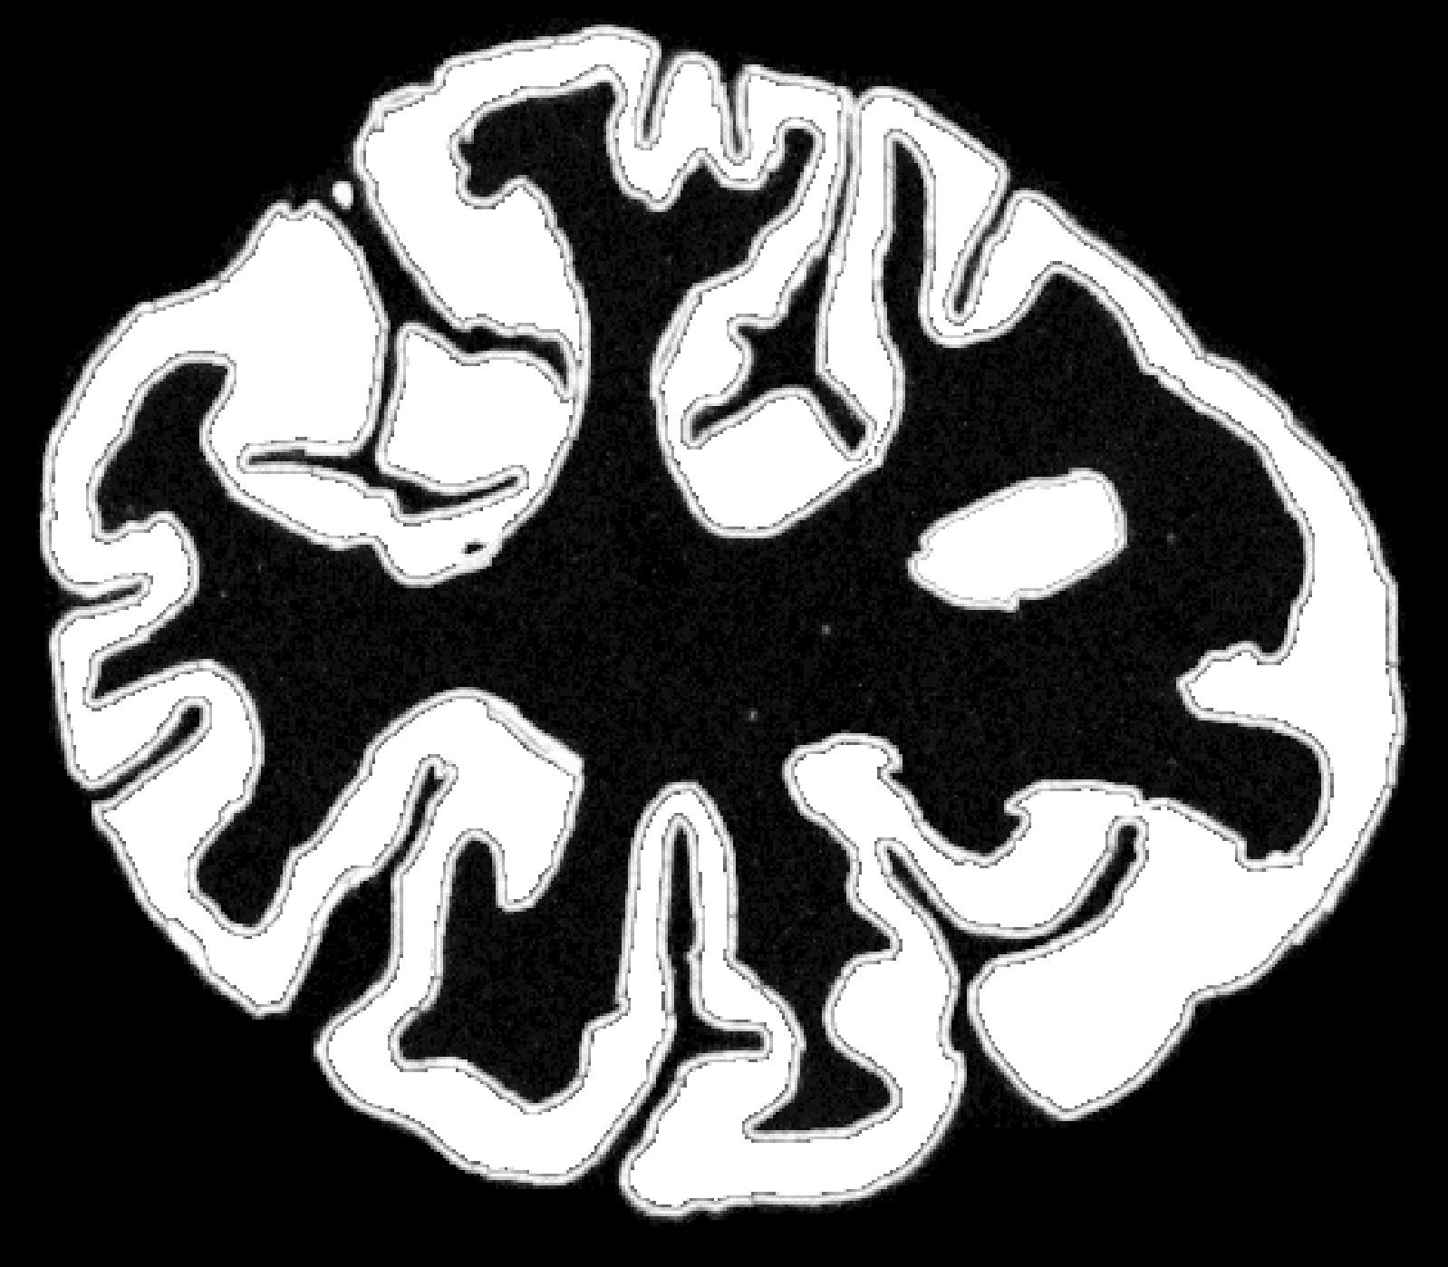
Manual Segmentation
Tools: GIMP (brush & bucket tool)
Outline brain images over a layer by using the brush tool to create a boundary between cortex & everything else
Then using the bucket tool to fill in the boundary with color

Slide 5
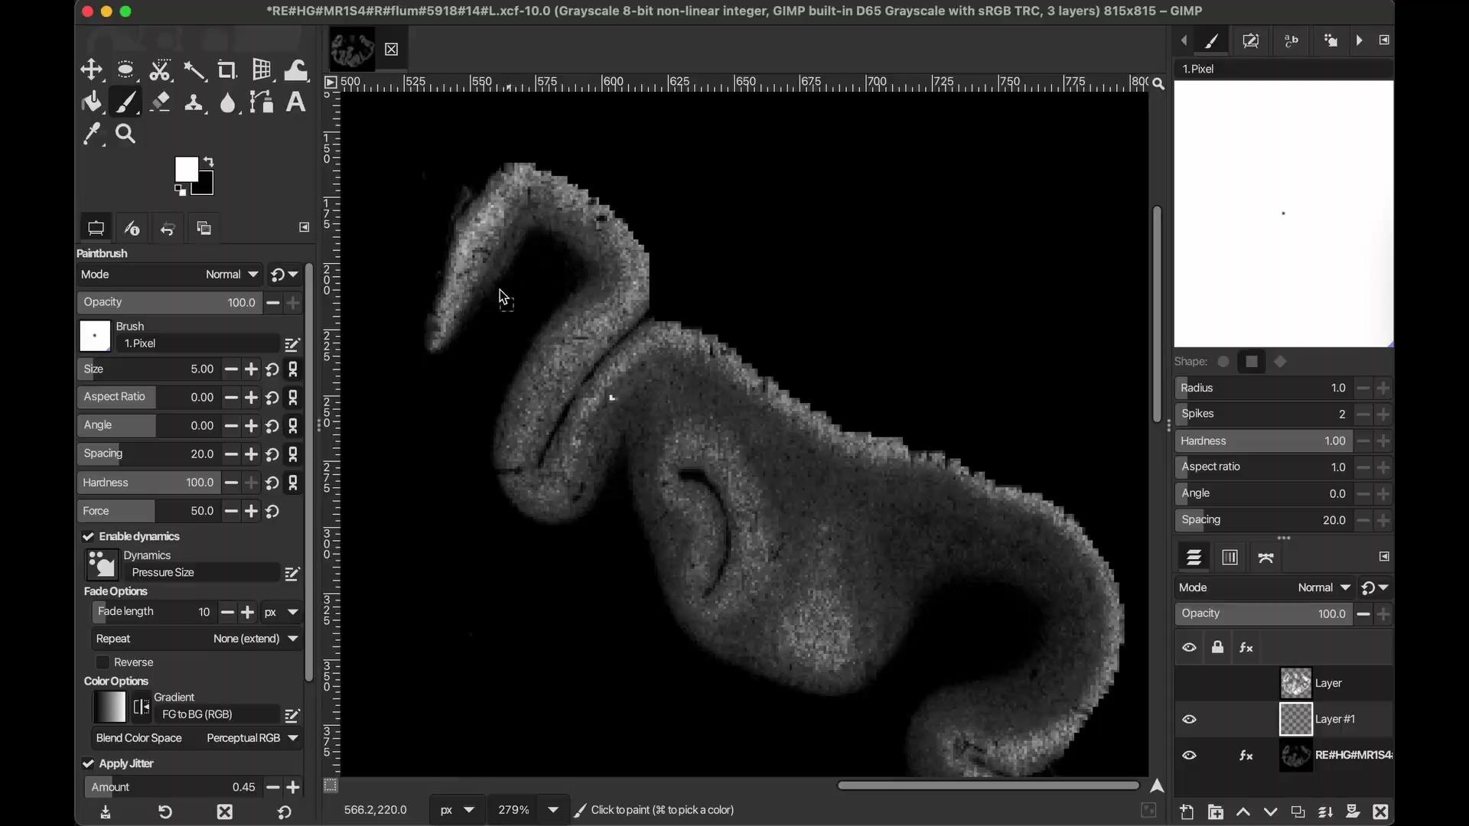
Notes:
Here is a video demonstration of what we did

Slide 6
But this takes a long time to do one by one…
..which is why we have automatic segmentation to compare

Slide 7
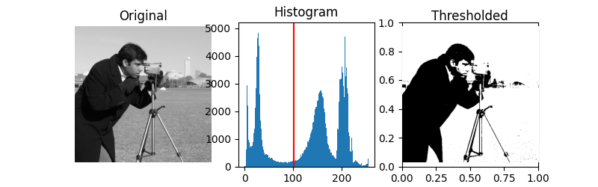
Otsu Thresholding
“Otsu's method is a popular technique employed for image thresholding. It separates an image into two classes, foreground, and background, based on the grayscale intensity values of its pixels”
Otsu Thresholding essentially plots the pixel values intensity on a histogram. The histogram is divided into 2 where the lightest values (first half) become the background and the the darkest values (second half) become the foreground.

Slide 8
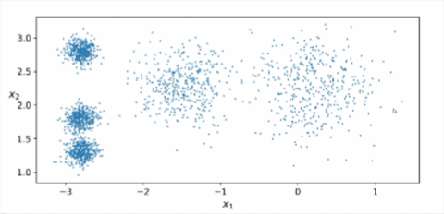
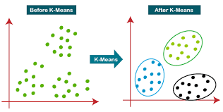
K-Means Clustering
There are 5 clusters here!
K = # of cluster groupings
K = # of cluster groupings
Data is grouped into clusters by randomized points of data
The algorithm selects random points of data as the grouper
These clusters are based on which division point is closest to it
There are 3 clusters here!

Slide 9
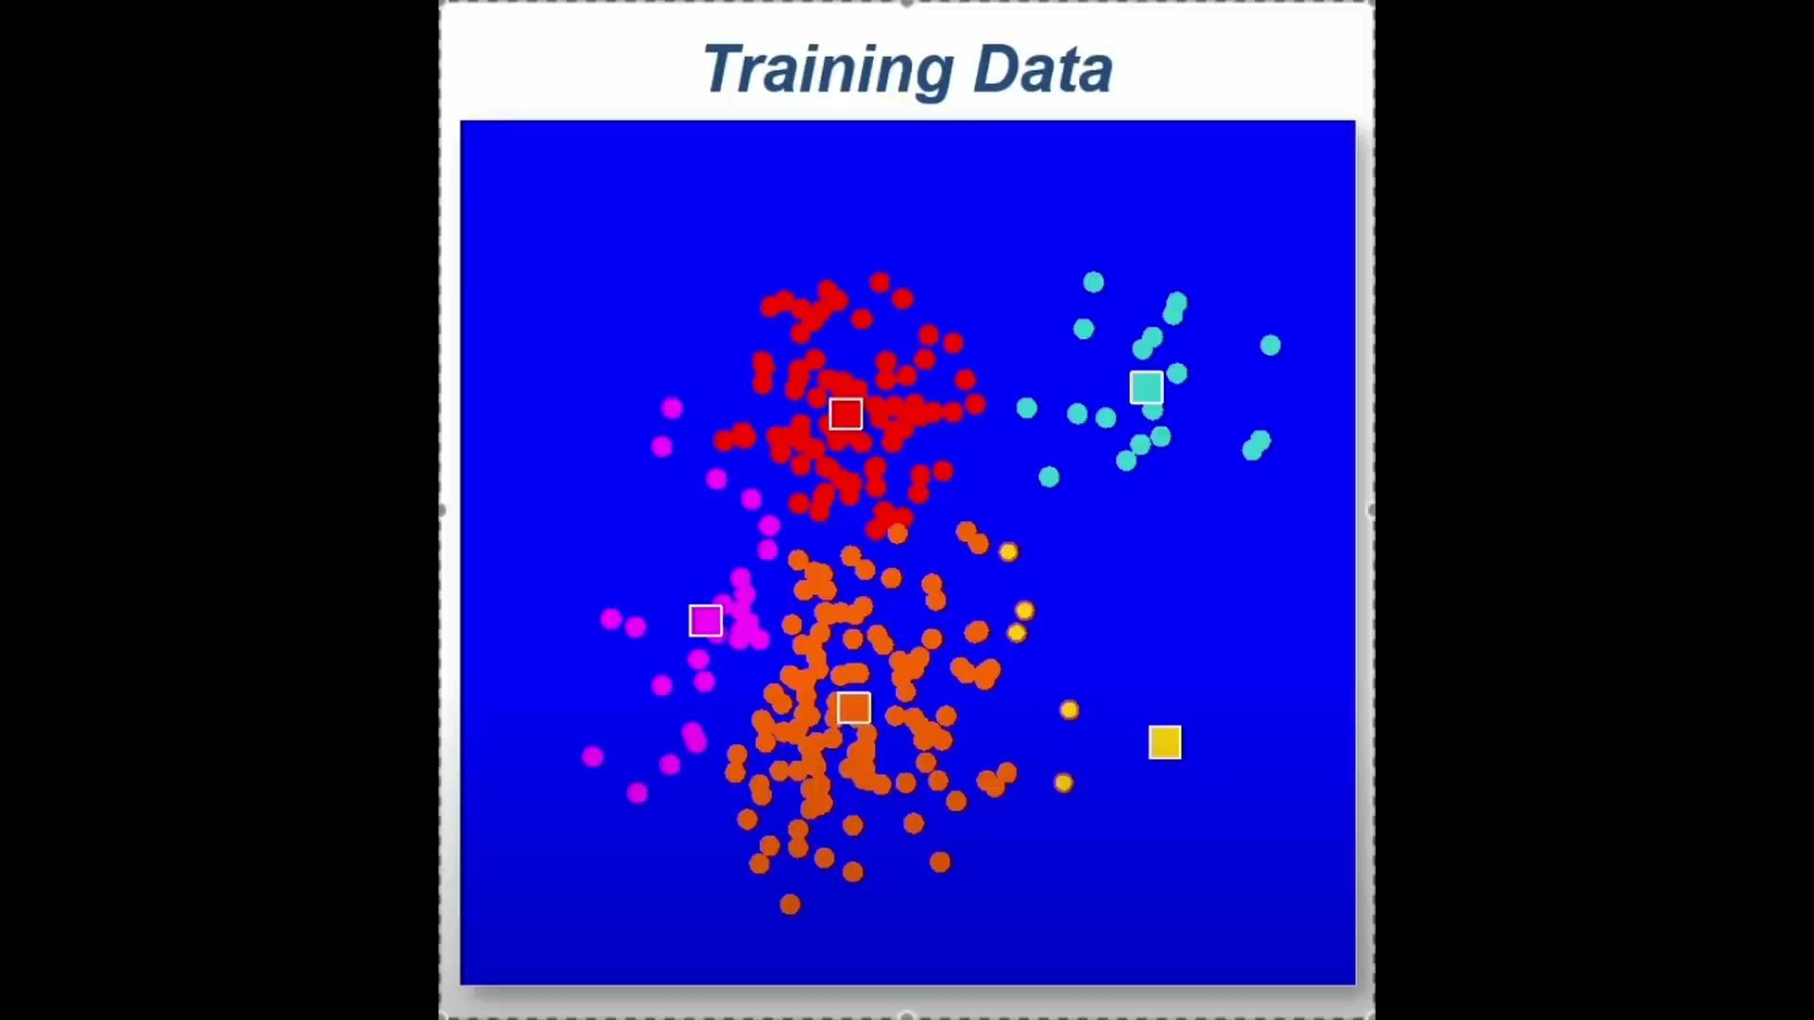
K-Means Clustering
The division points of each cluster are automatically readjusted to be equidistant to every other point
The clusters are reshaped again based on the closest distance to the division point
This process repeats until a cluster cannot be readjusted further

Slide 10
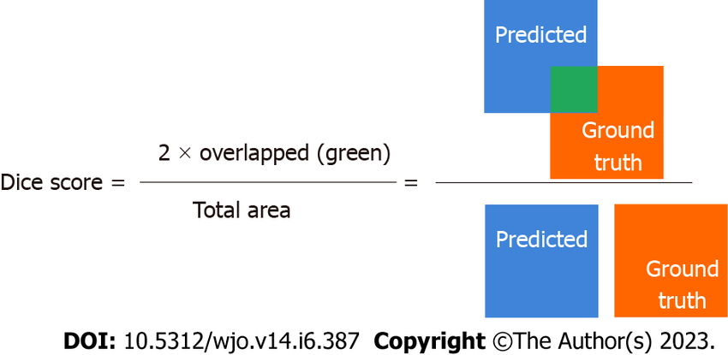
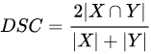
Dice Score
“The Dice score, also known as the Dice Similarity Coefficient, is a metric used to assess the similarity between two sets of data, often binary or categorical”
-AI Policy Observatory-
In image segmentation, a dice score tells you how accurate the automatic segmentation is to the “ground truth segmentation” (the accurate segmentation).

Slide 11
That’s some really nice information…
..but what does it look like on a brain image?

Slide 12
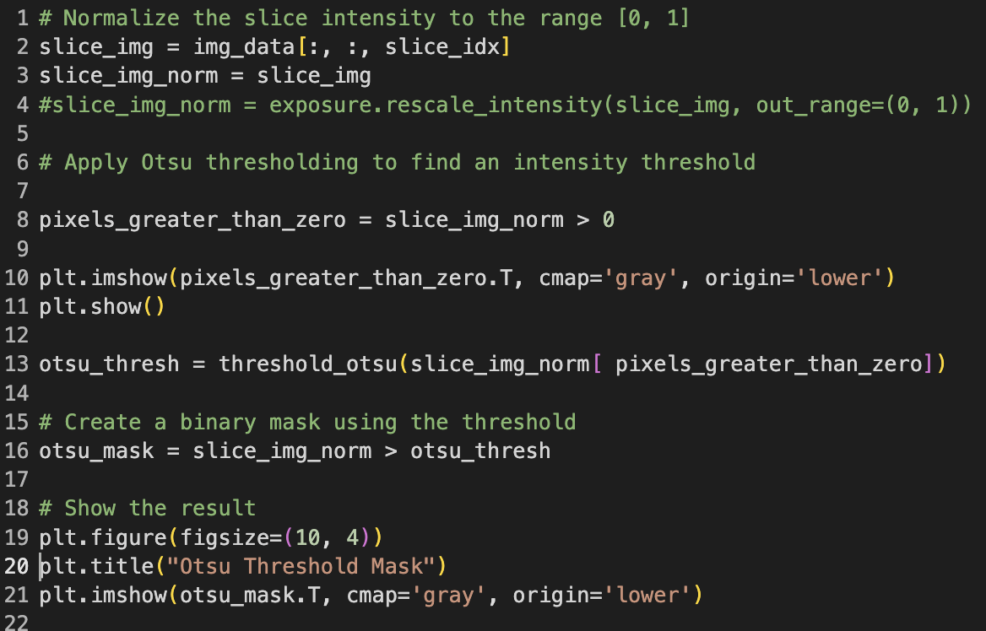
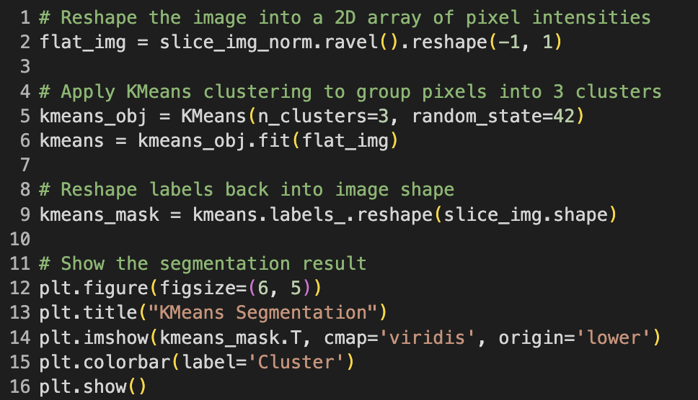
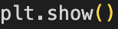
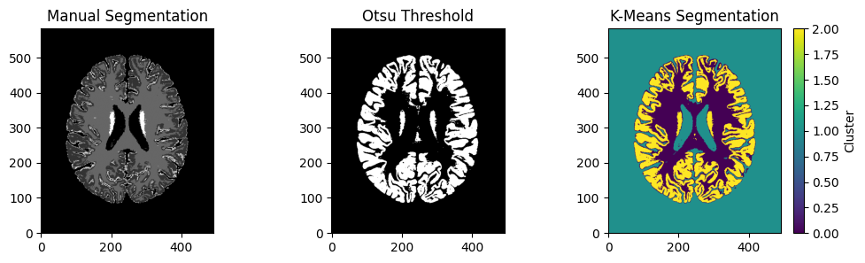
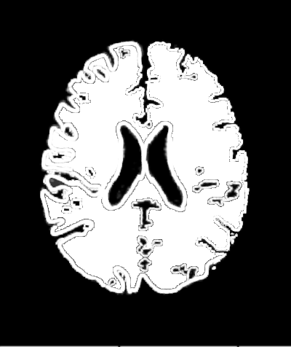
Manual vs Otsu vs K-Means Segmentation
Example Code; not actual**

Slide 13
Key Takeaways and Setbacks
C.J Harris
Takeaway:
Coding on a new program like python even with previous coding experience (C++) is still extremely hard to learn.
Learn coding it like learn another language.
Setbacks:
Slow laptop
Extremely busy
Carlos
Key Takeaways:
Coding is challenging, but rewarding!
I need to take a formal coding class
Neuroimaging is way more interesting than I had thought
Setbacks:
No Coding Experience
Slow Laptop
Time Management
Josh
Key Takeaway:
Using Python for neuroscience is a rabbit hole I want to explore more
I will be practicing image segmentation in the future
Setbacks:
External responsibilities to work
Difficulty learning multiple different Python libraries

Slide 15
Q&A!!
Notes:
What is the difference between python and other programs? Python uses AI to assist with coding and can even help you with error and give you example coding. While C++ is more basic there is no AI to assist you
What is the purpose of this?

